Slide 1
Localize the Openbravo ERP system into Sinhala language and Implement it with the university system.
Comprehensive Design/Analysis Project
Group No-16-071

Slide 2
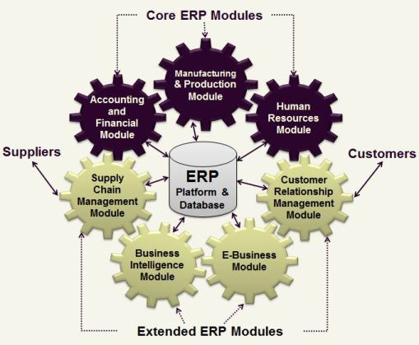
Background..
Enterprise Resource Planning (ERP)
Openbravo
Localization

Slide 3

Main Objectives…
Localize the Openbravo ERP system to Sinhala.
Implement the localize system to the university system.

Slide 4

Specific Objectives…
To gain operational benefits.
To gain managerial benefits.
To gain organizational benefits.
To gain intangible benefits.

Slide 5
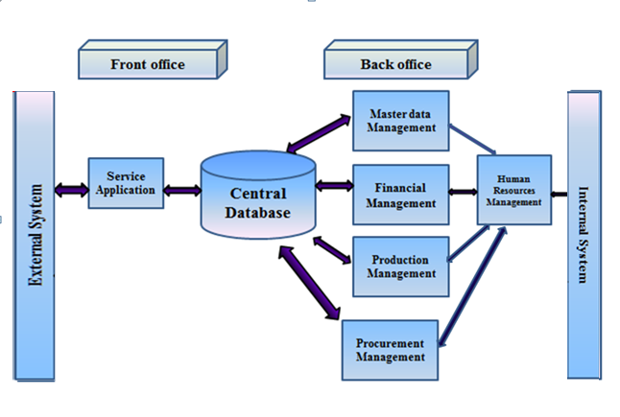
System Diagram

Slide 6
Existing Open source ERP systems
Oppentapss
OpenERP
ERP5
OpenBravo

Slide 7
Why we use Openbravo
Opentaps |  |  |  | Open ERP | ERP5 | Openbravo
Oppentaps mainly support only to the e–commerce |  |  |  | Small medium company cannot implement OpenERP. Features are limited . | Selenium is basically one-directional So we can not put complex expression to it. | Openbravo support all kind of business organization. openbravo also can use small , medium And large company. openbravo is immpliment using java so we can easily localize it .so we propose to localize openbravo ERP system.

Slide 8
Uses of the system
Internal
external

Slide 9
Research Methodology
Software………
Openbravo ERP
JDK
Apache ANT
Apache Tomcat
PostgreSQL
NetBeans IDE

Slide 10


Slide 11
Any Questions ?

